Slide 1
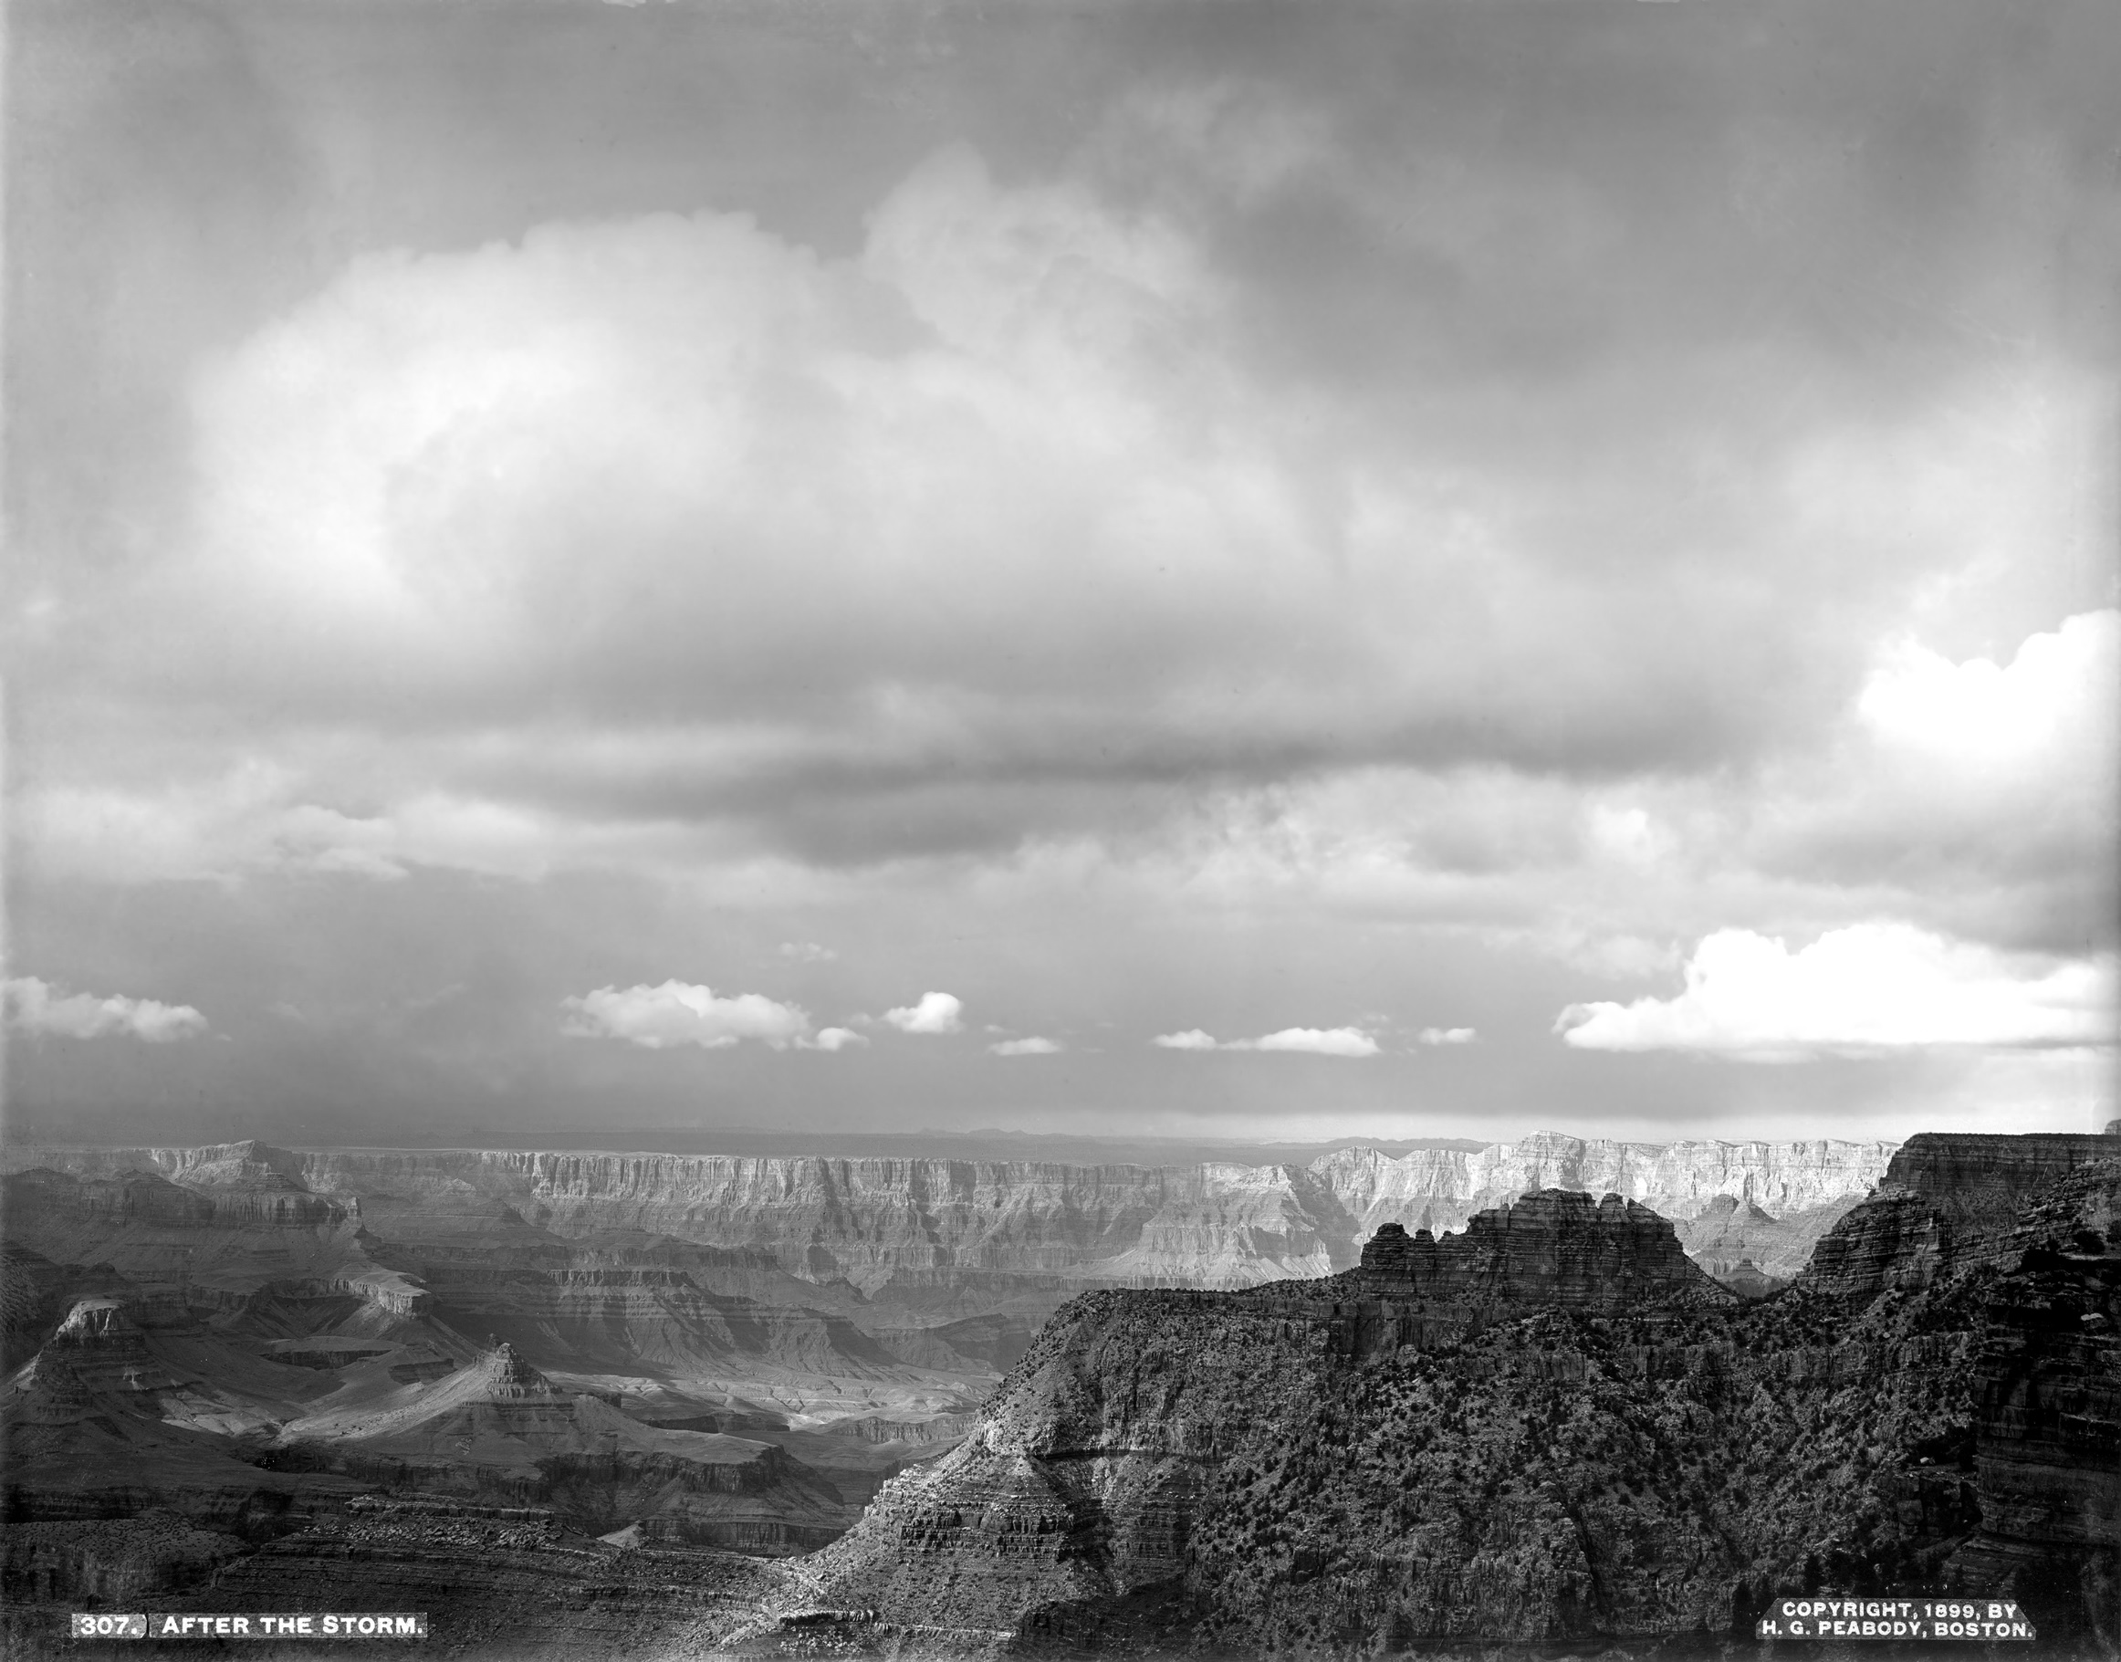

Design and Digital Publishing
Representing Theoretical Advances in the Geohumanities
Nicholas Bauch
Assistant Professor,
Geography
University of Oklahoma
Henry Peabody, After the Storm, 1899. Courtesy The Huntington Library, San Marino, Calif.

Slide 2
1.
STANFORD UNIV. PRESS’
DIGITAL PUBLISHING INITIATIVE

Slide 3
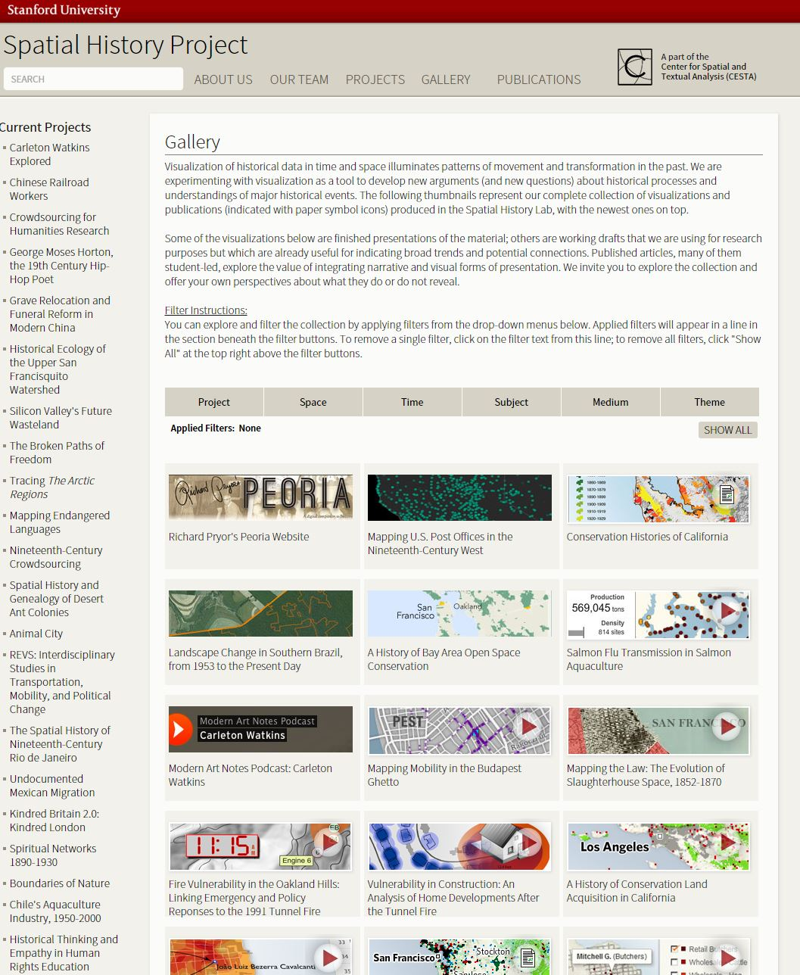
Spatial History Project.
Detail of Project Gallery.
Stanford University

Slide 4
“For the most part these hosting models do not share common benchmarks or standards and very few incorporate rigorous peer review processes …
- Alan Harvey, Director, Stanford U. Press

Slide 5
“For the most part these hosting models do not share common benchmarks or standards and very few incorporate rigorous peer review processes …
    … It is our intent to give scholars an opportunity to accumulate a digital publishing pedigree that provides the same consideration for hiring and tenure as traditional book publishing offers.”
- Alan Harvey, Director, Stanford U. Press

Slide 6
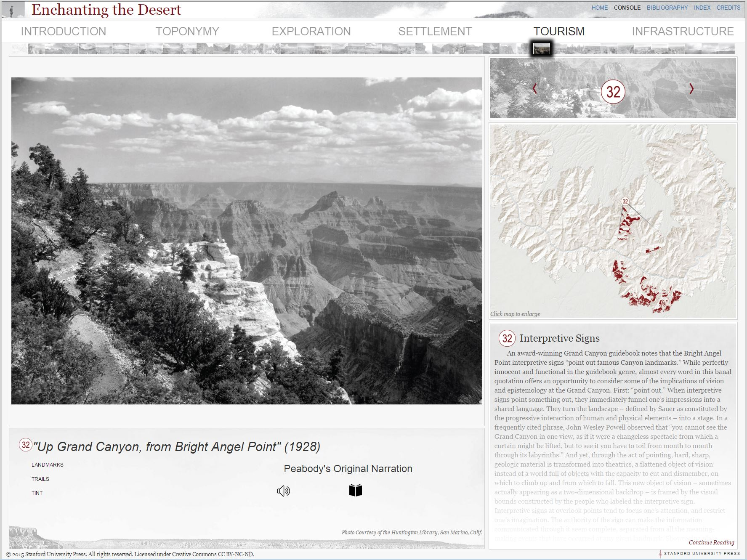

Slide 7
2.
DEMONSTRATION

Slide 8
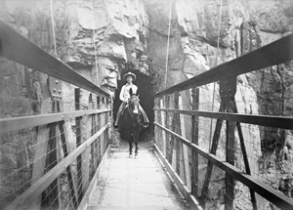
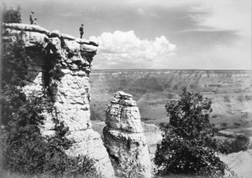
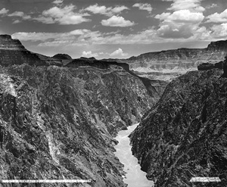
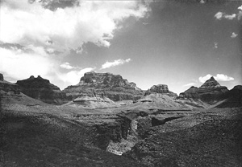
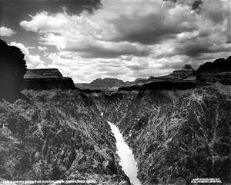
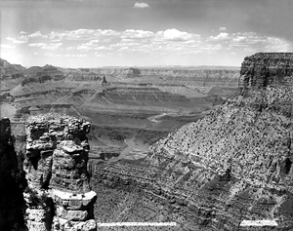
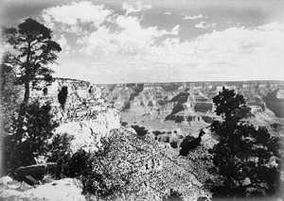
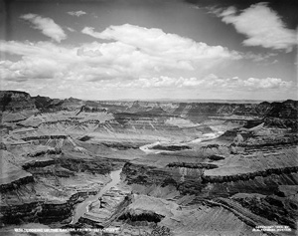
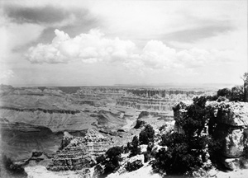
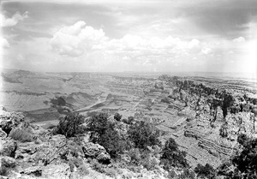
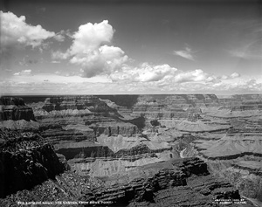
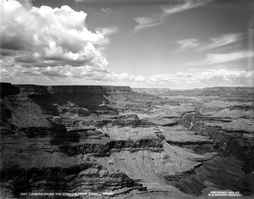
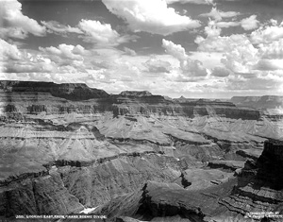
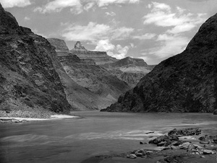
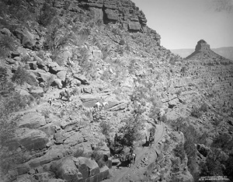
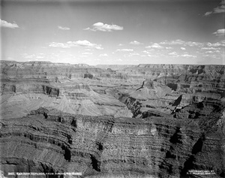
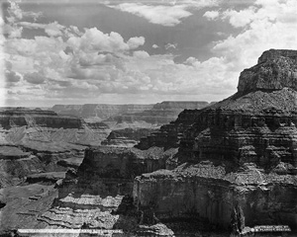
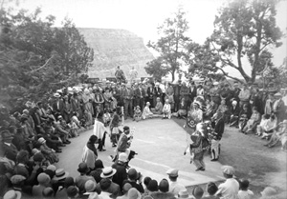
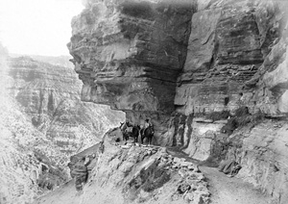
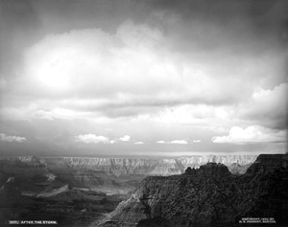
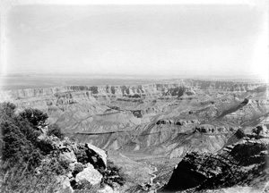
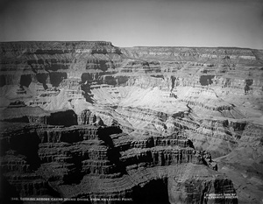
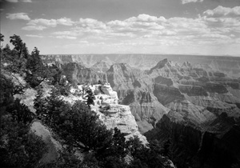
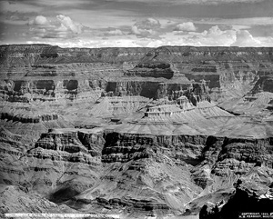
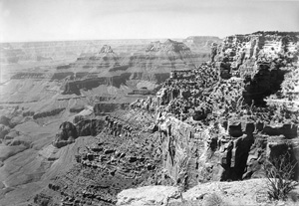

Slide 10
How could I operationalize Peabody’s photographs into an interpretive cultural geography?

Slide 11
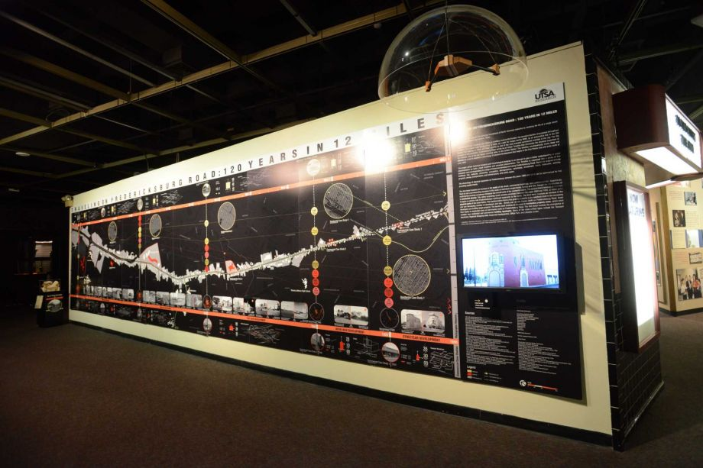
Traveling on Fredericksburg Road: 120 Years in 12 Miles. Institute of Texan Cultures Museum, San Antonio, Texas, 2013.

Slide 12
SPATIAL EPISTEMOLOGY
Objects existing in proximity are considered, a priori, related

Slide 13
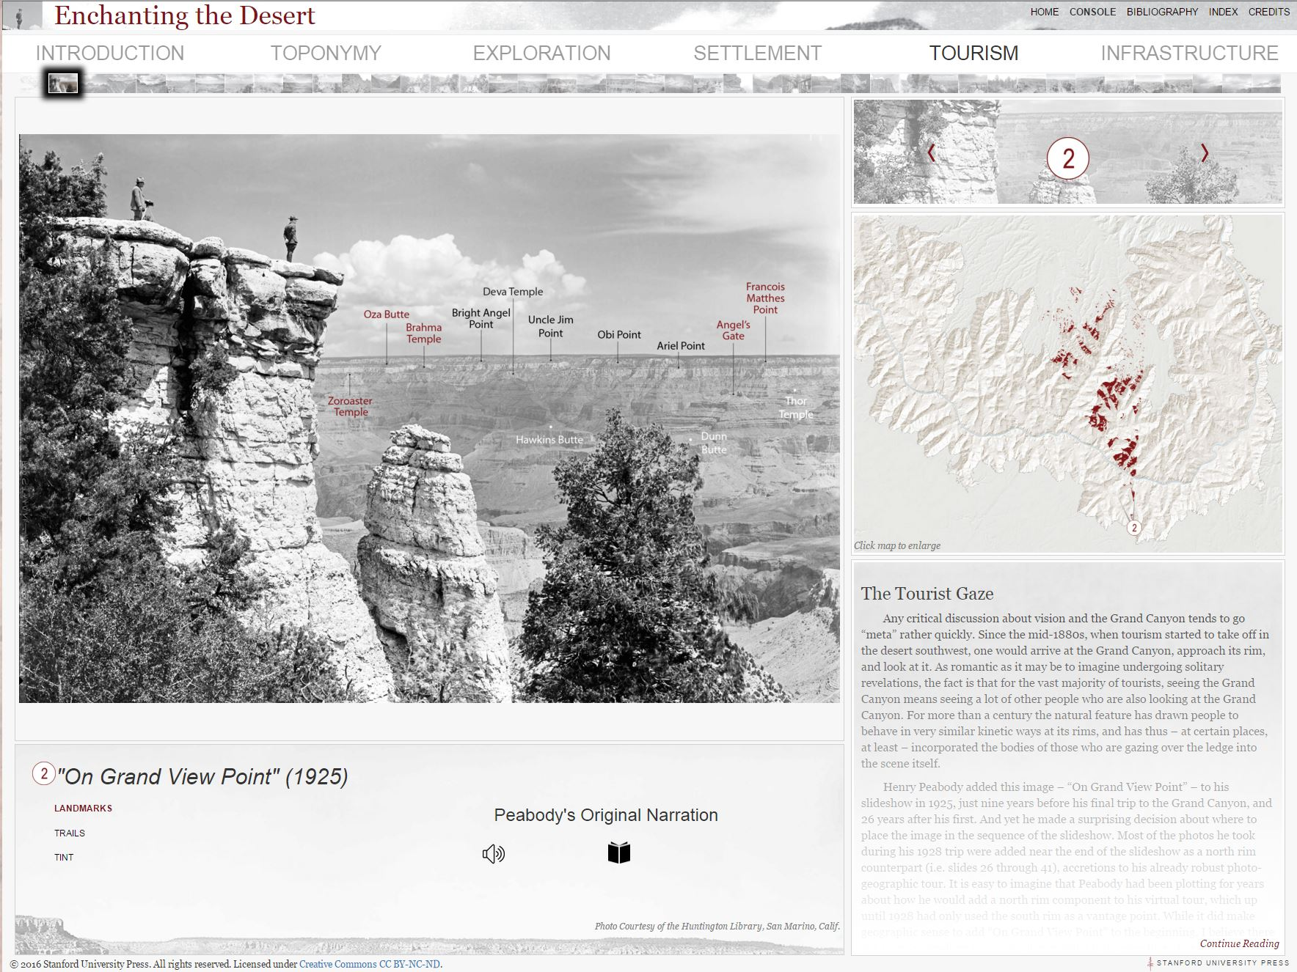

Slide 14
DIGITAL PLATFORM ALLOWS:
Proximity to organize information
Landscape to become an epistemology

Slide 15
3.
ACTUALIZING
GEOGRAPHIC THEORY

Slide 16
3.
ACTUALIZING
GEOGRAPHIC THEORY
Representing multiple spatial ontologies concurrently

Slide 17
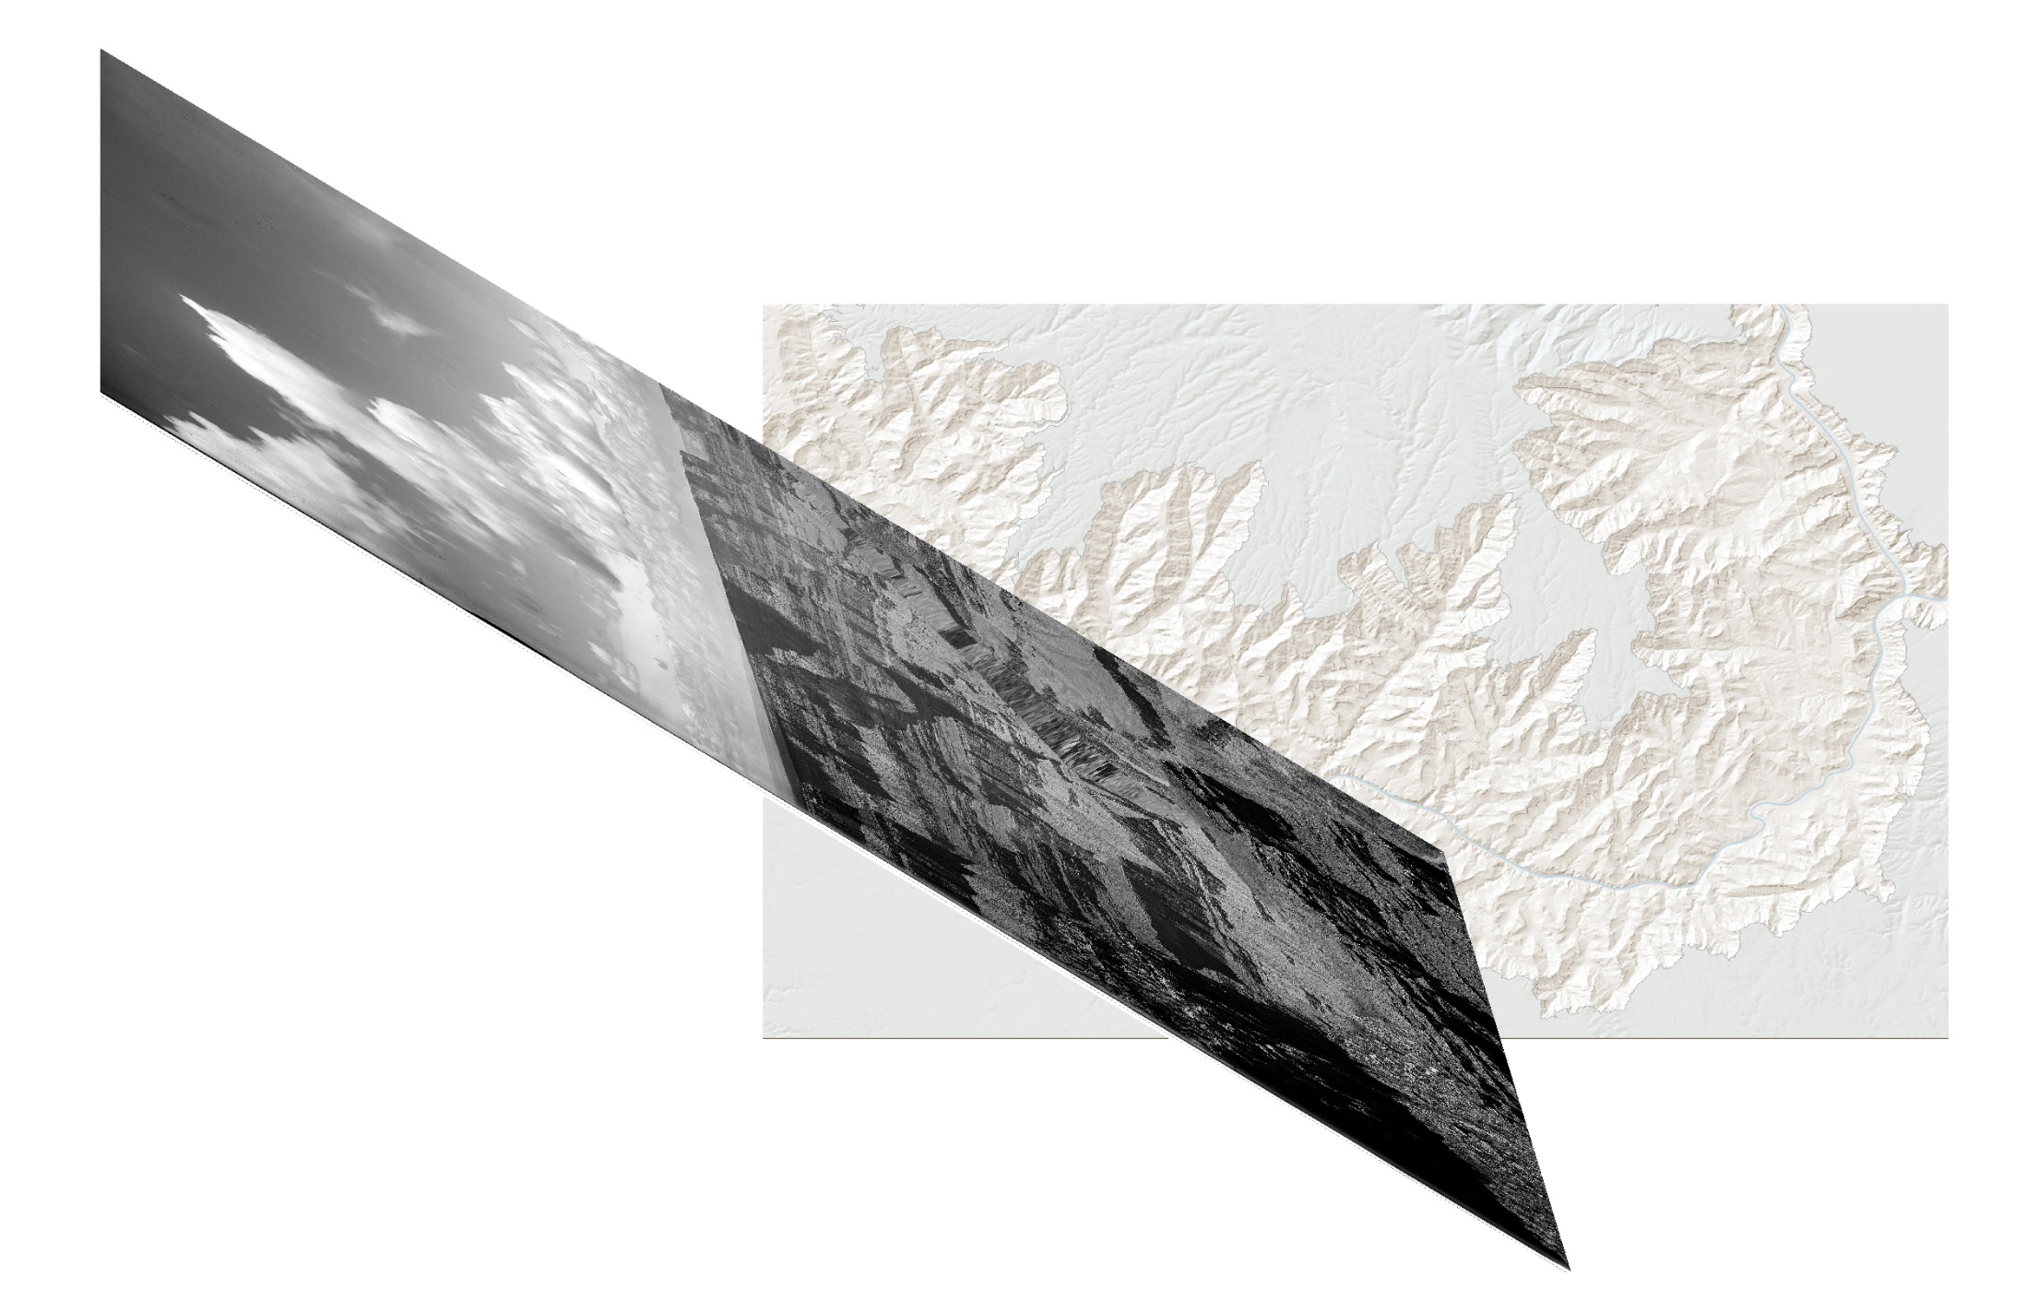

Slide 18
3.
ACTUALIZING
GEOGRAPHIC THEORY
Representing multiple spatial ontologies concurrently
Describing how exactly space is “produced”

Slide 19
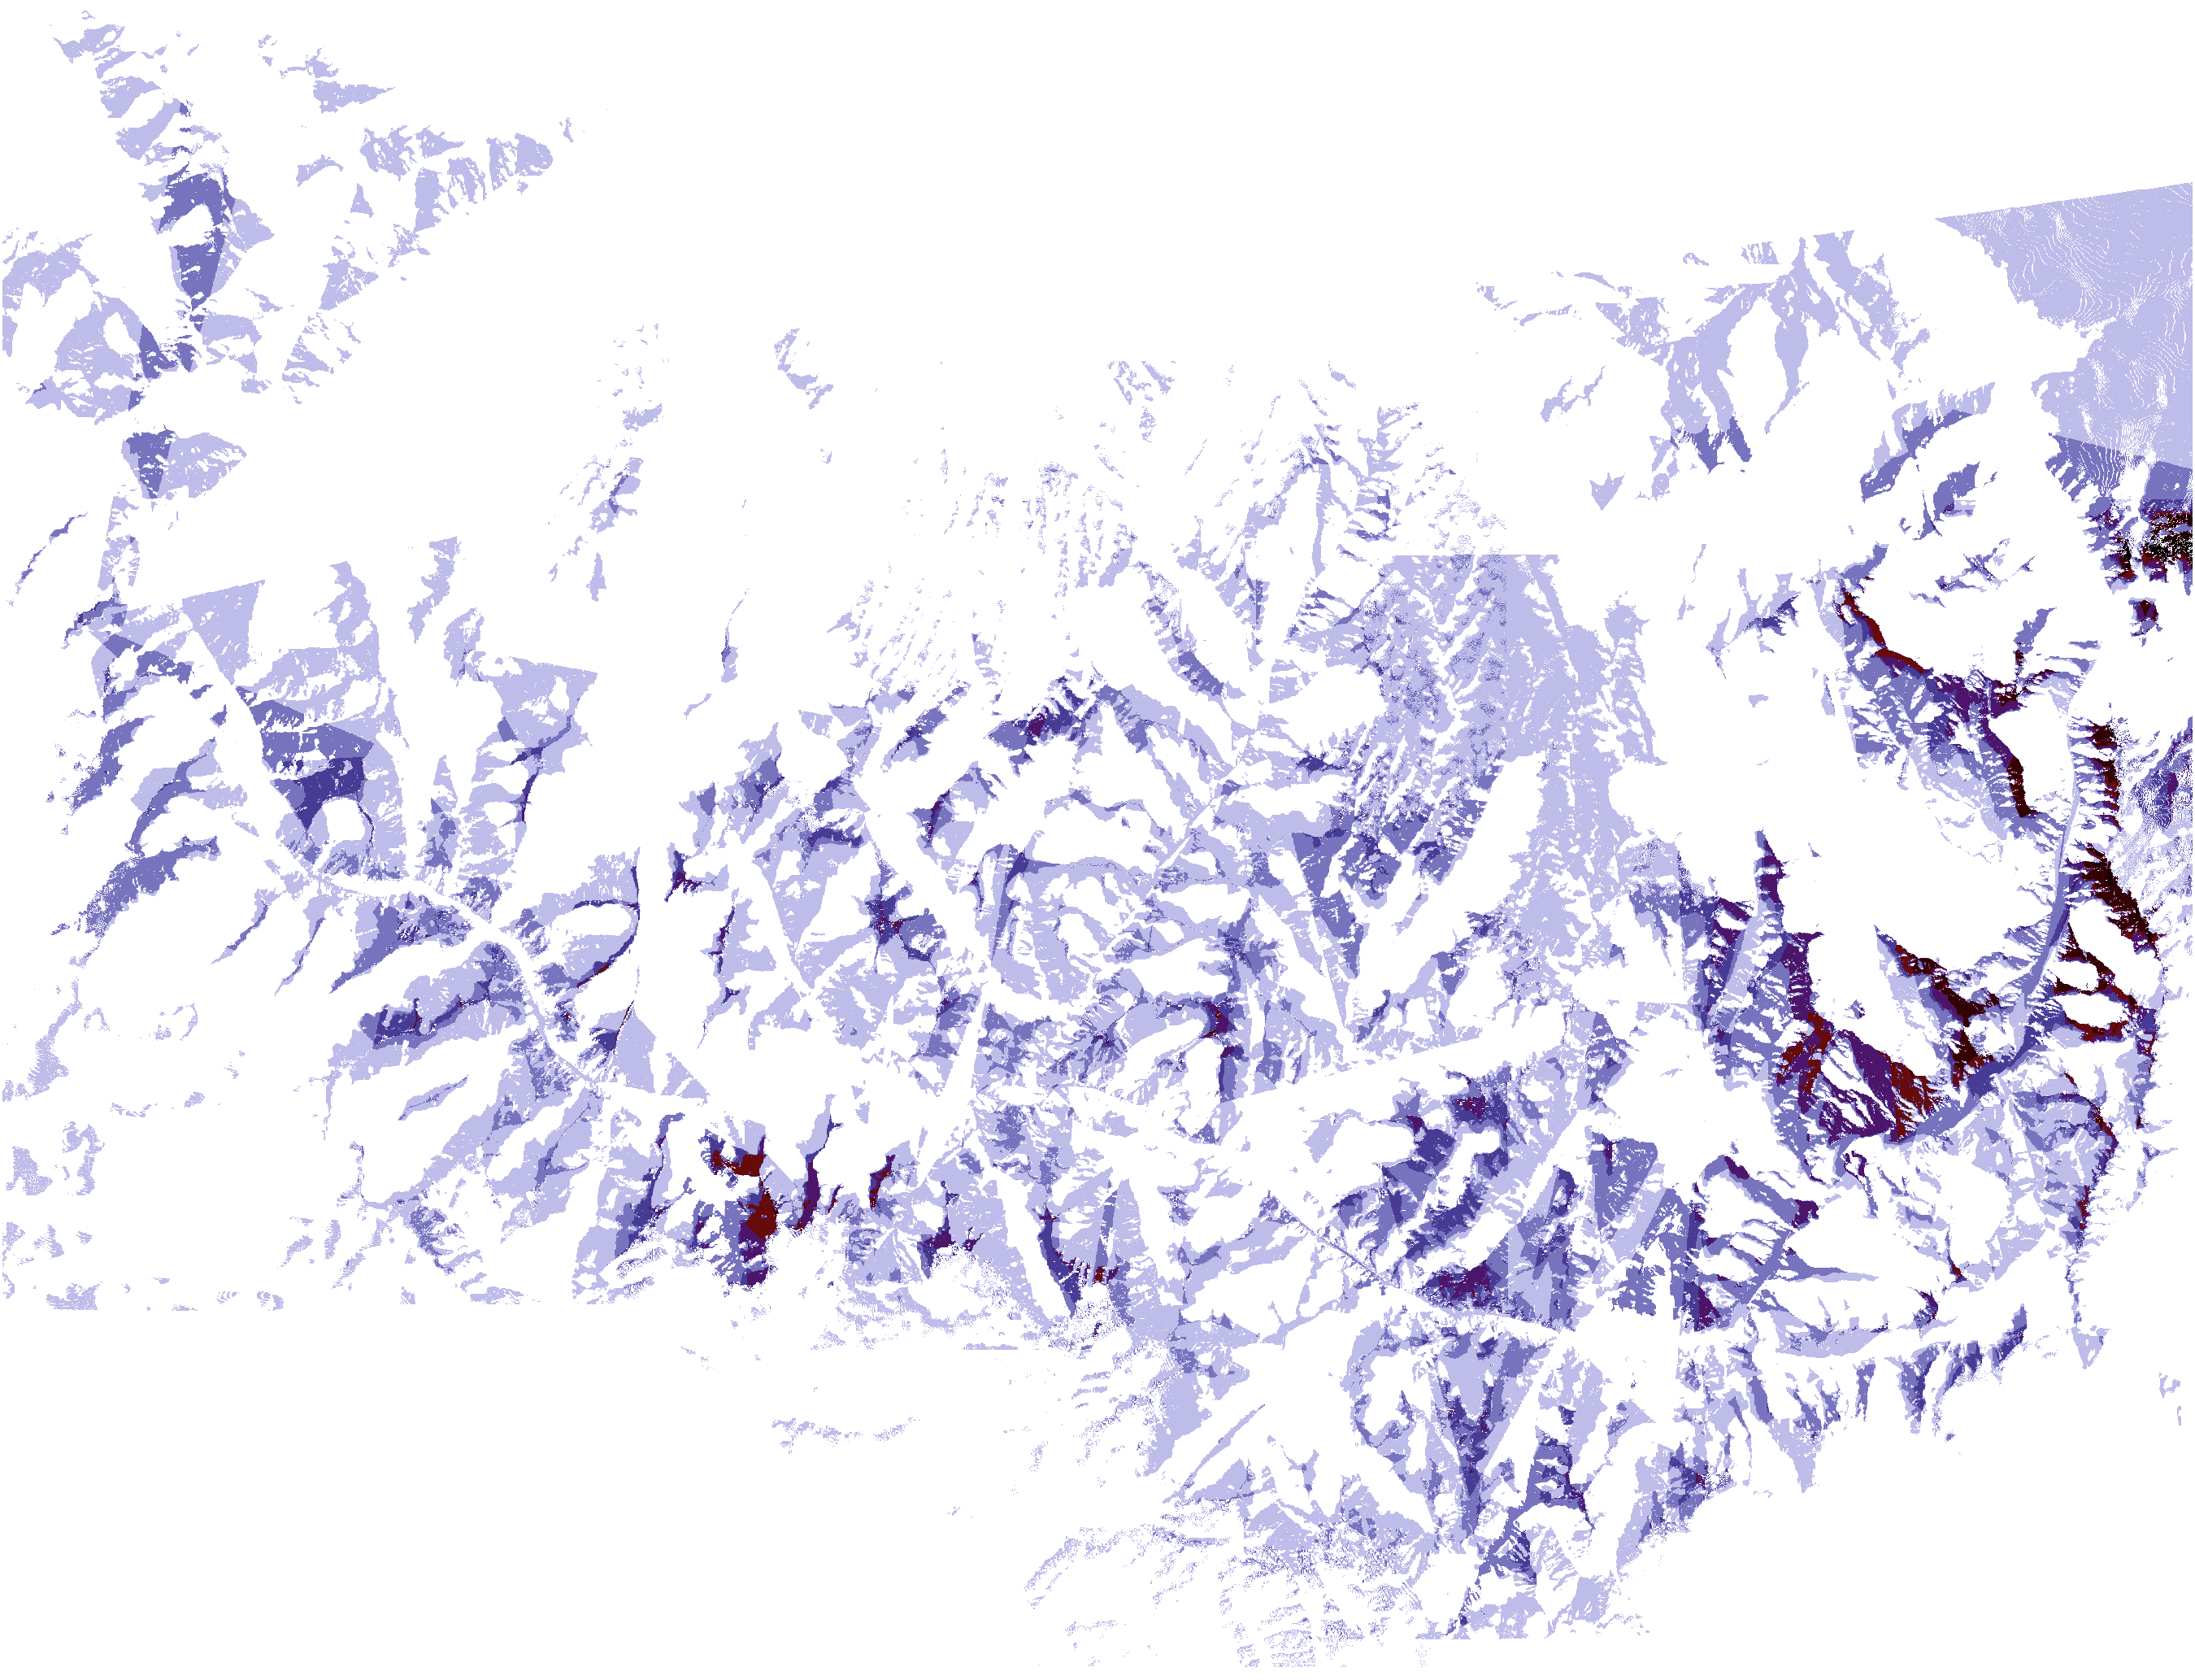

Slide 20
4.
DESIGN AND
DIGITAL PUBLISHING

Slide 21
COMMON CONCERNS
Hosting
Maintenance
Peer review
Pricing

Slide 22
We need the DNA of book publishing as we mutate into a new form of publishing

Slide 23
How do we preserve and archive the heterogeneous array of author-designed digital products?’

Slide 24
MAIN CHALLENGE
IN DIGITAL PUBLISHING
Authors and Presses need to blend:
User-interface design (“artistic”)
with
Web archiving design (“technical”)

Slide 25
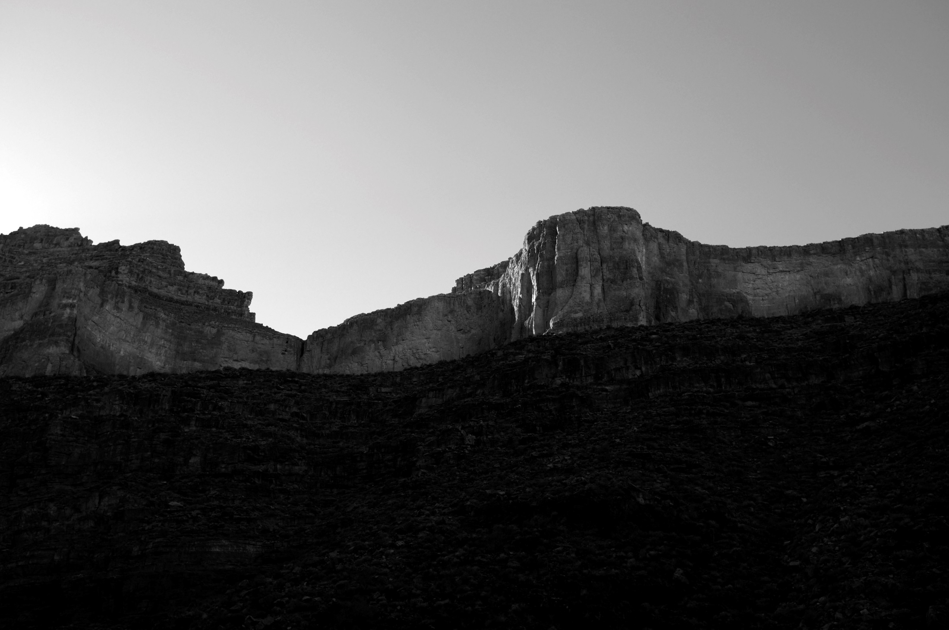
THANK YOU!
Nicholas Bauch
nbbauch@ou.edu
www.nicholasbauch.com
THE BEGINNING …
Photo by N. Bauch, 2013, South Bass Trail, Grand Canyon.

Slide 27
Screen Shot Backups for live demo

Slide 28
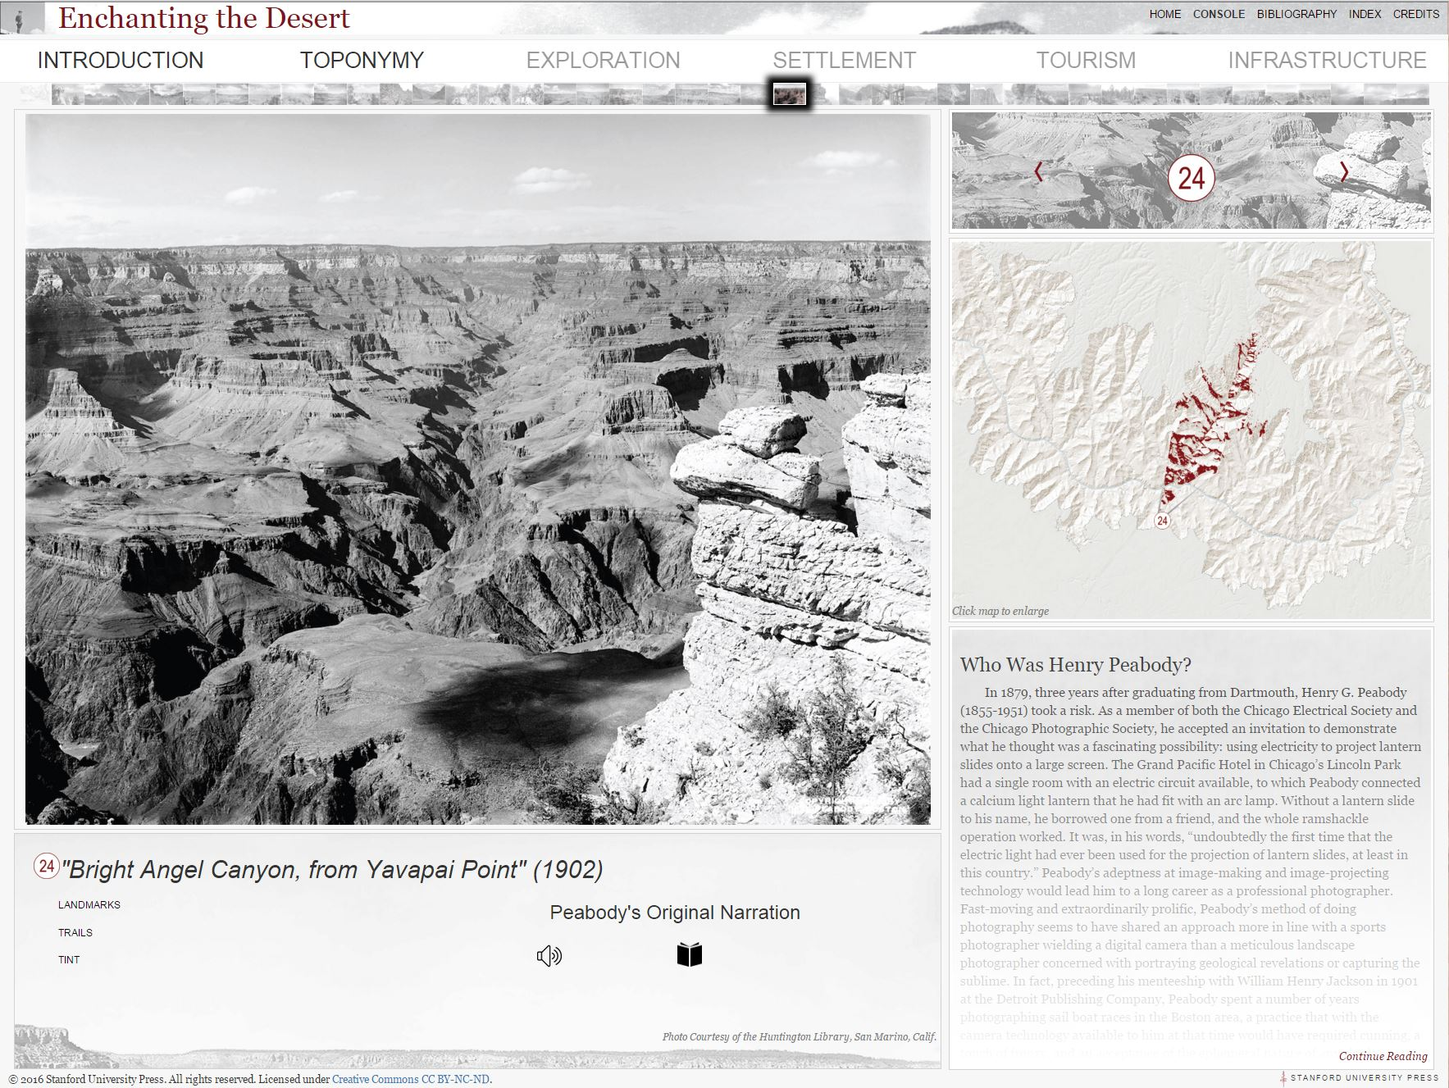

Slide 29
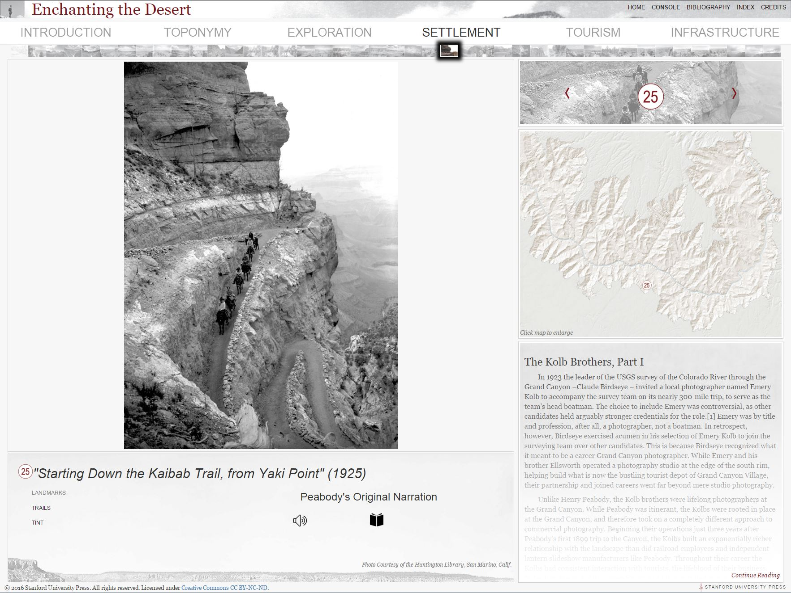

Slide 30
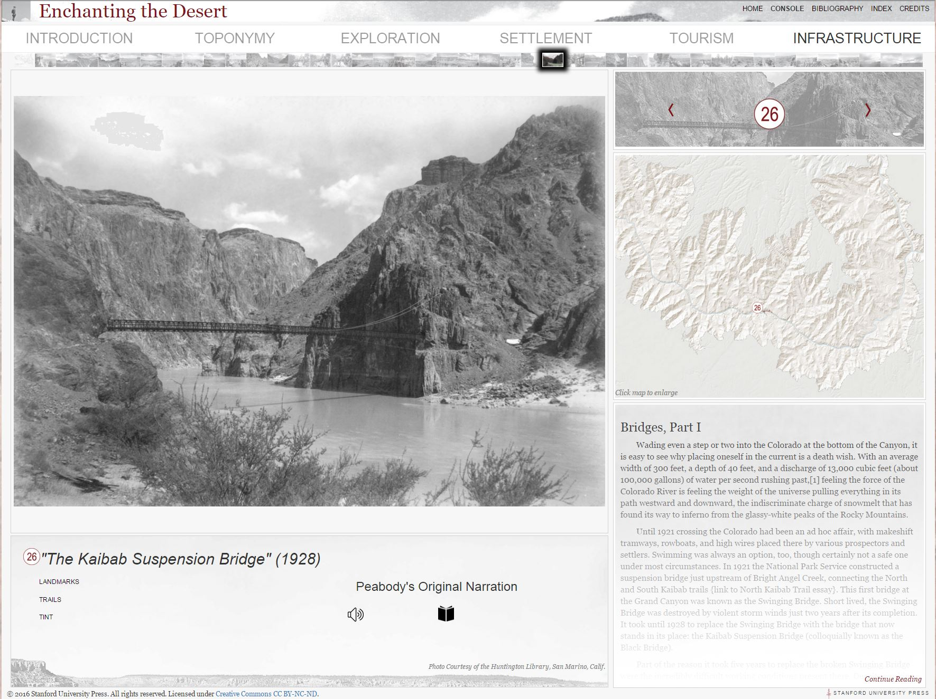

Slide 31
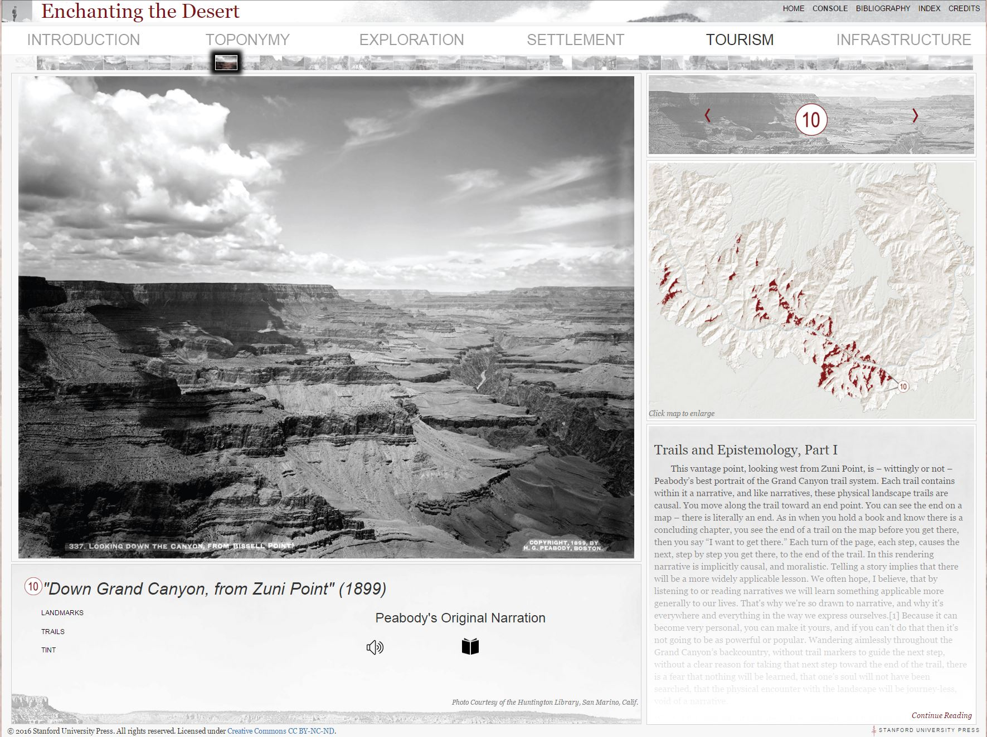

Slide 32


Slide 33


Slide 34


Slide 35
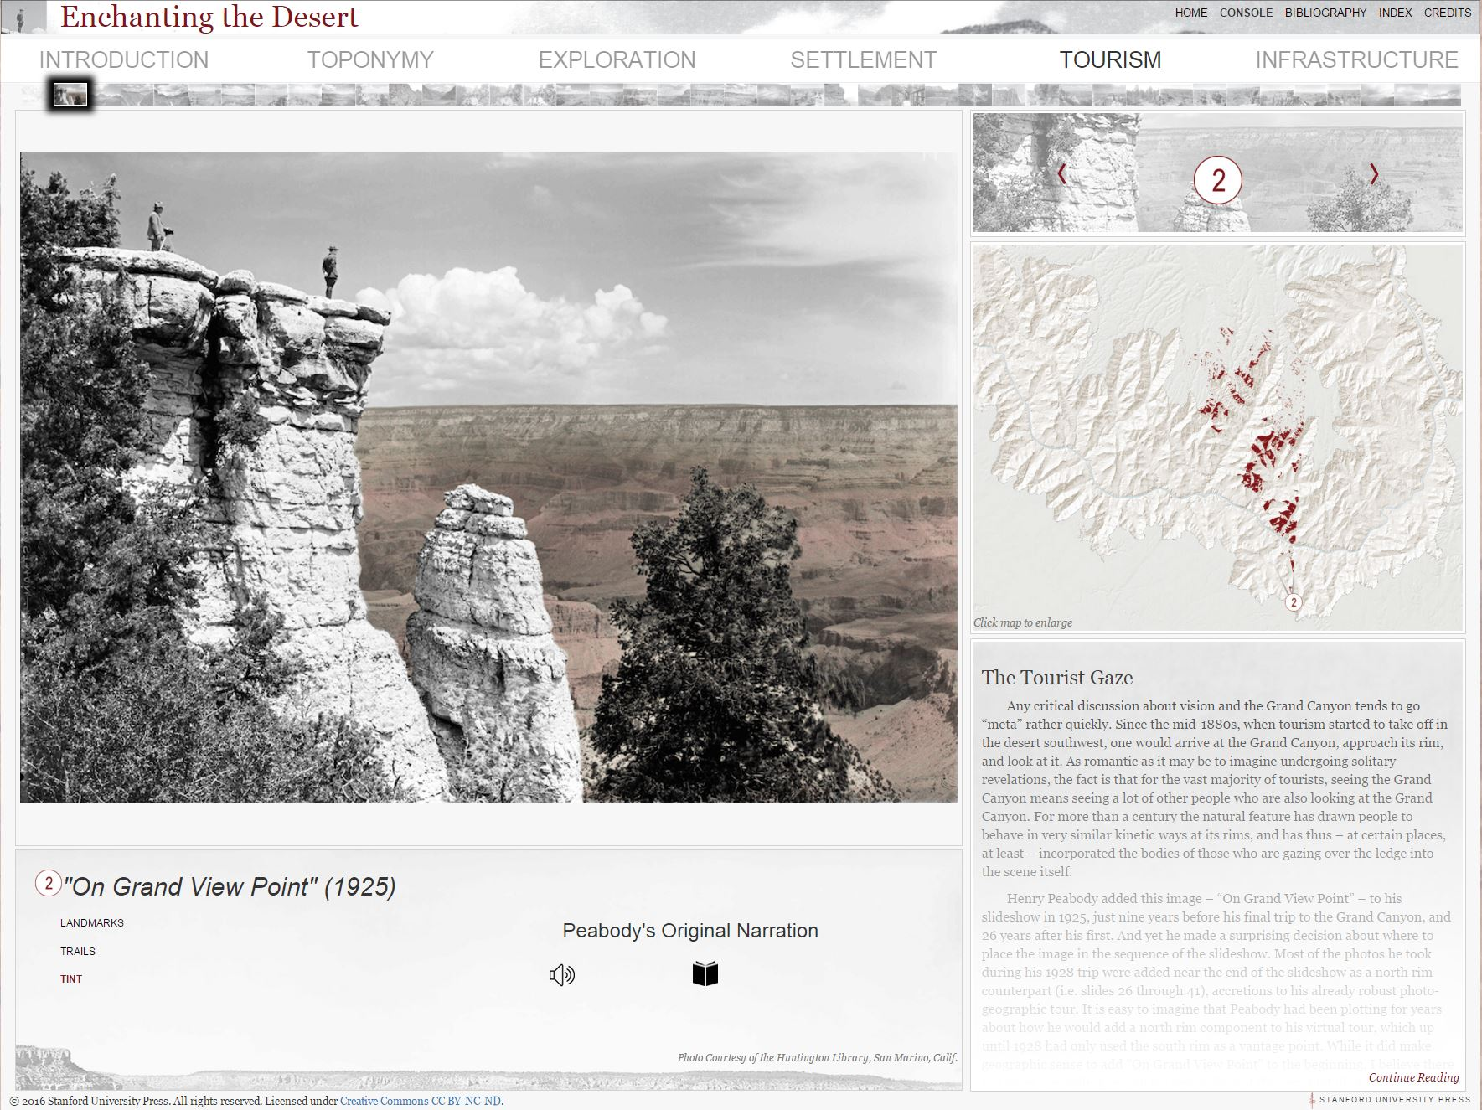

Slide 37
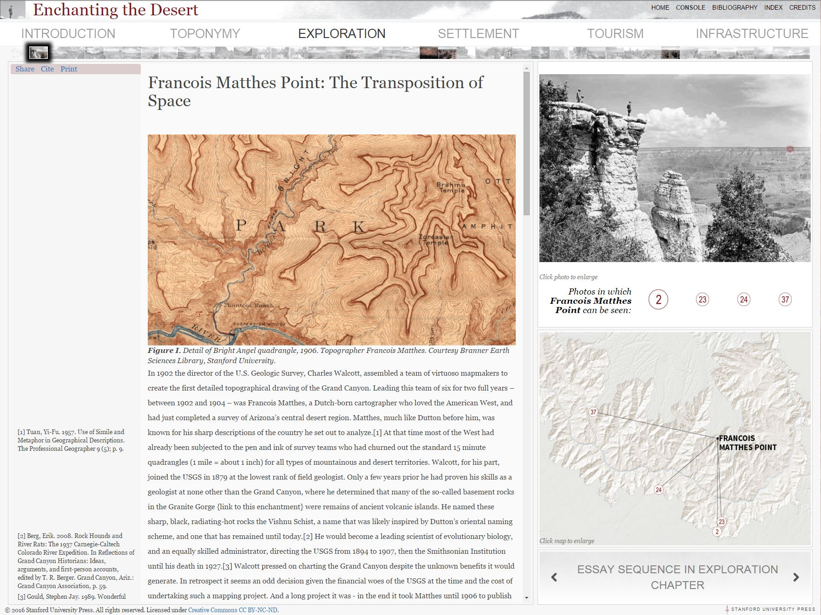

Slide 38
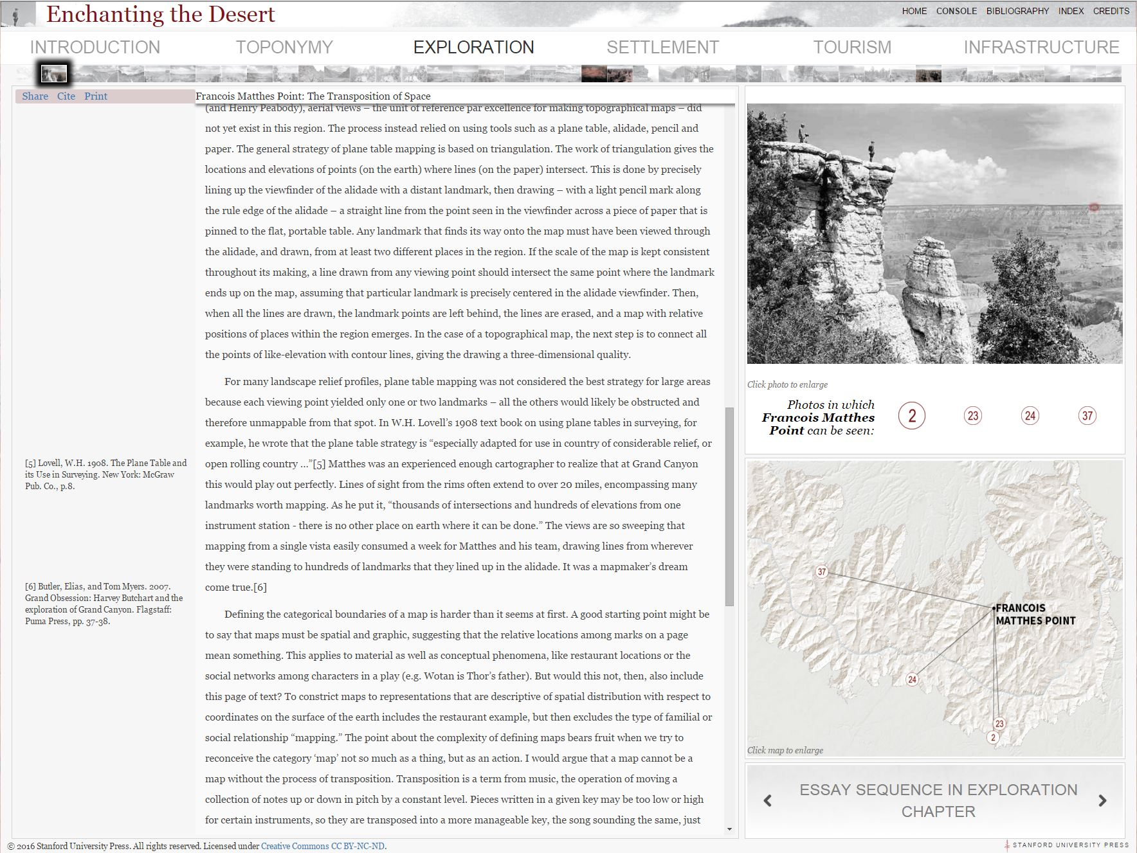

Slide 39
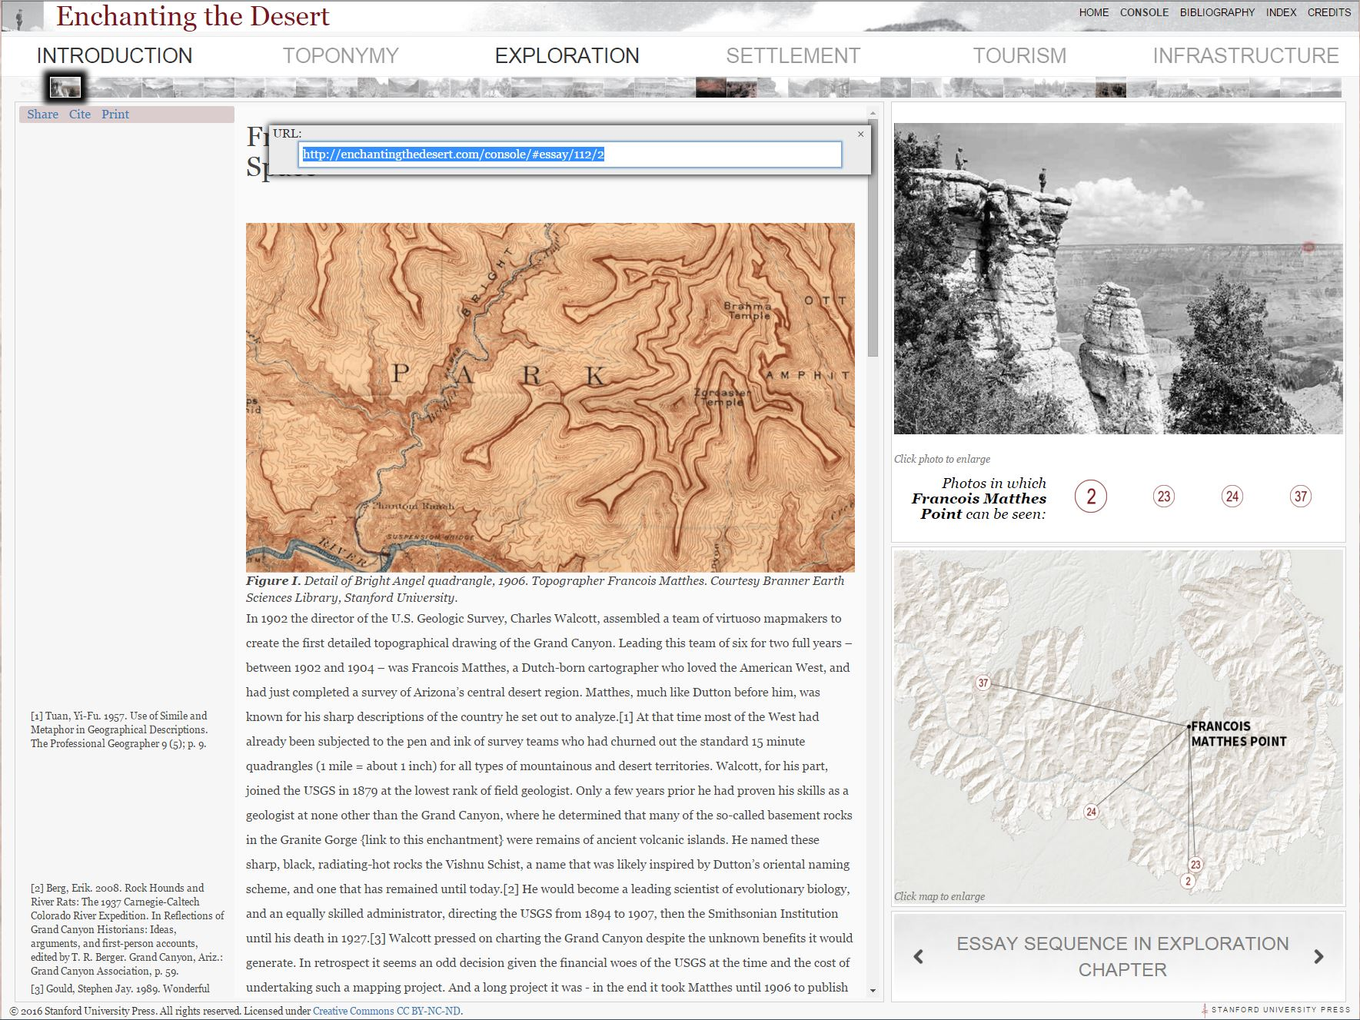

Slide 40
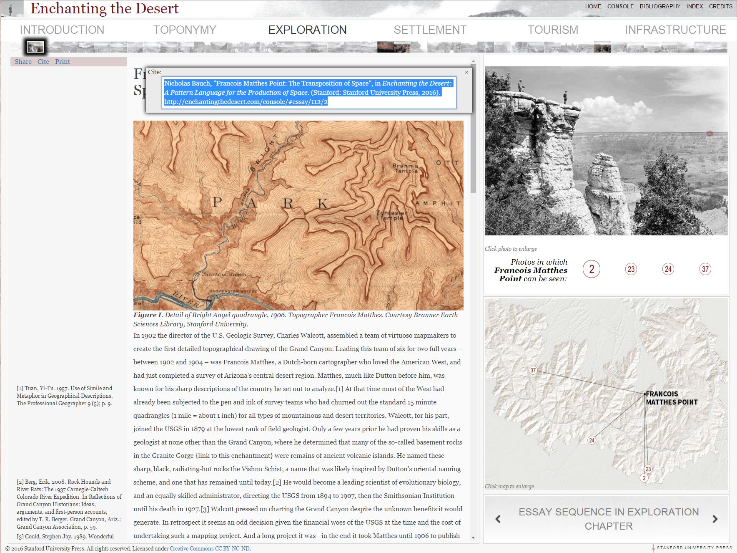

Slide 41
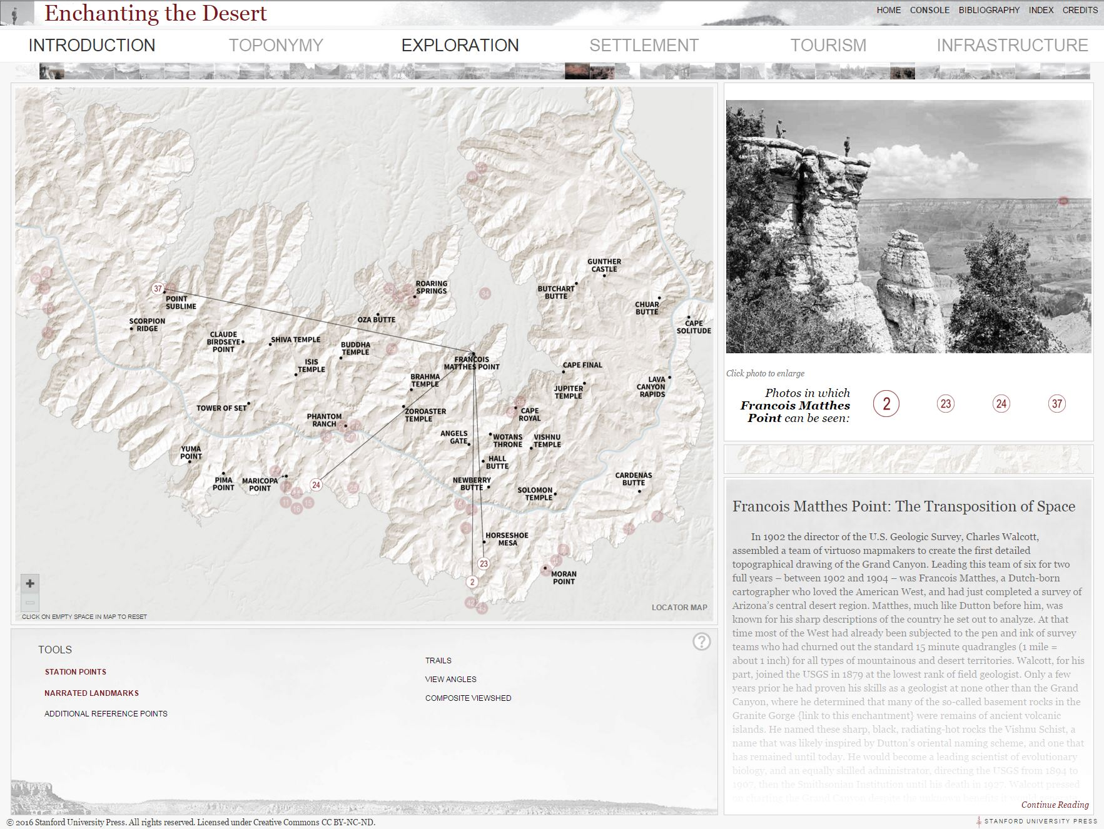

Slide 42
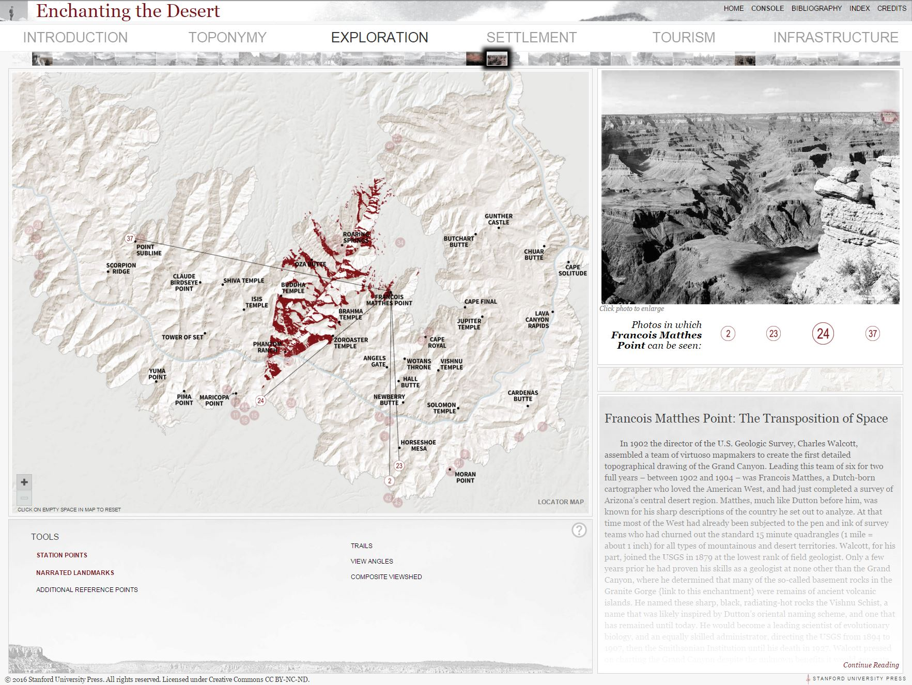

Slide 43
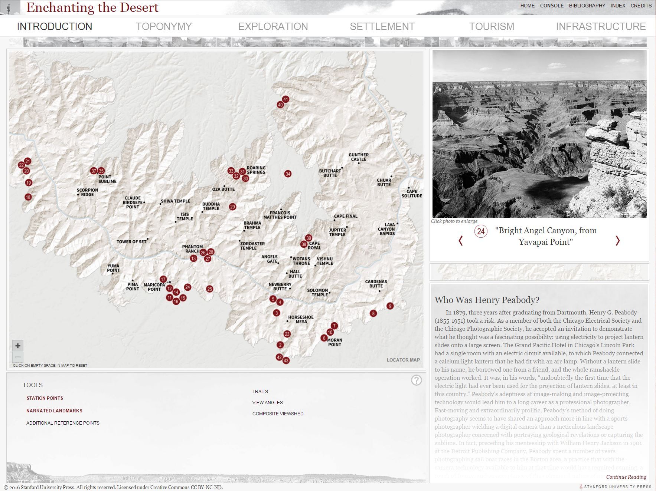

Slide 44
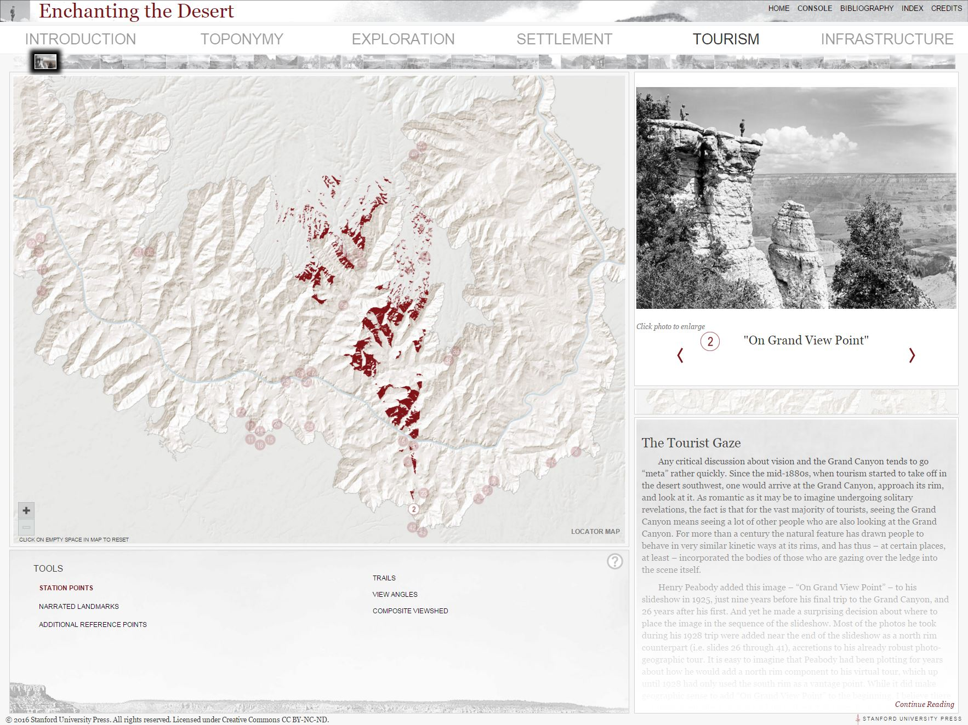

Slide 45
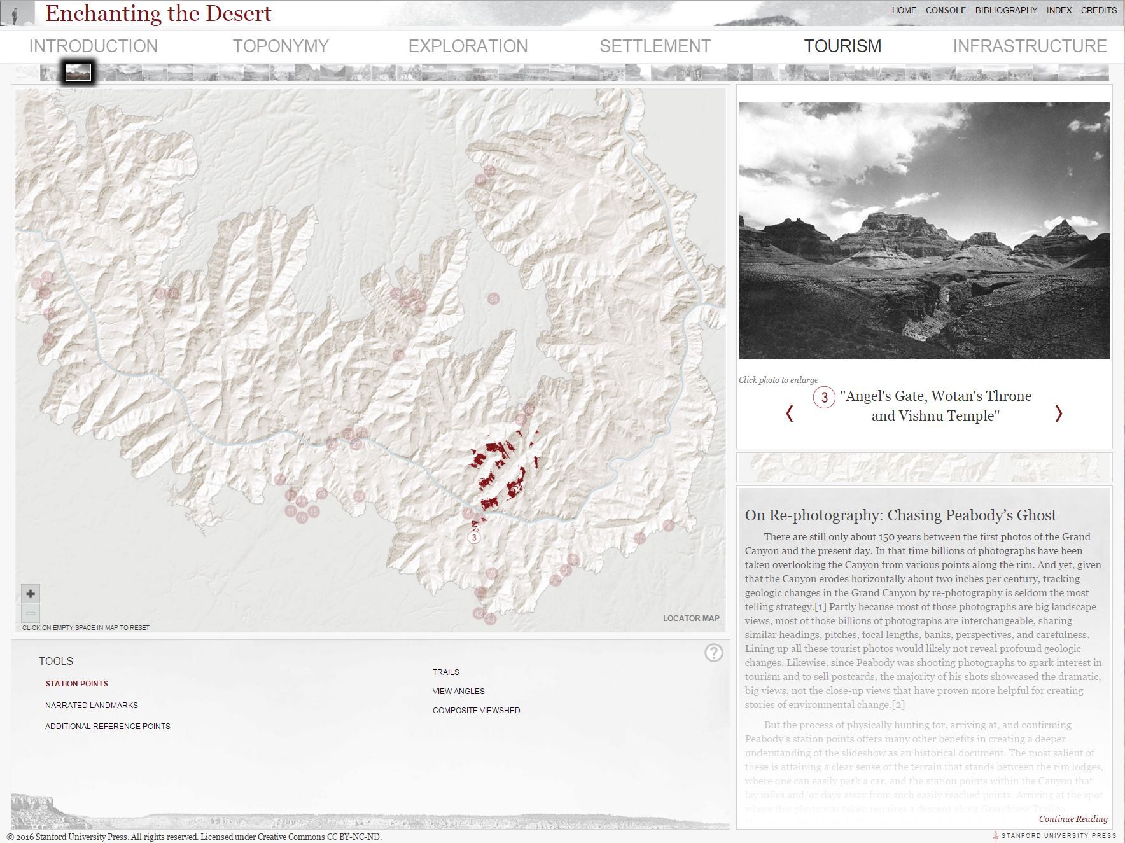

Slide 46
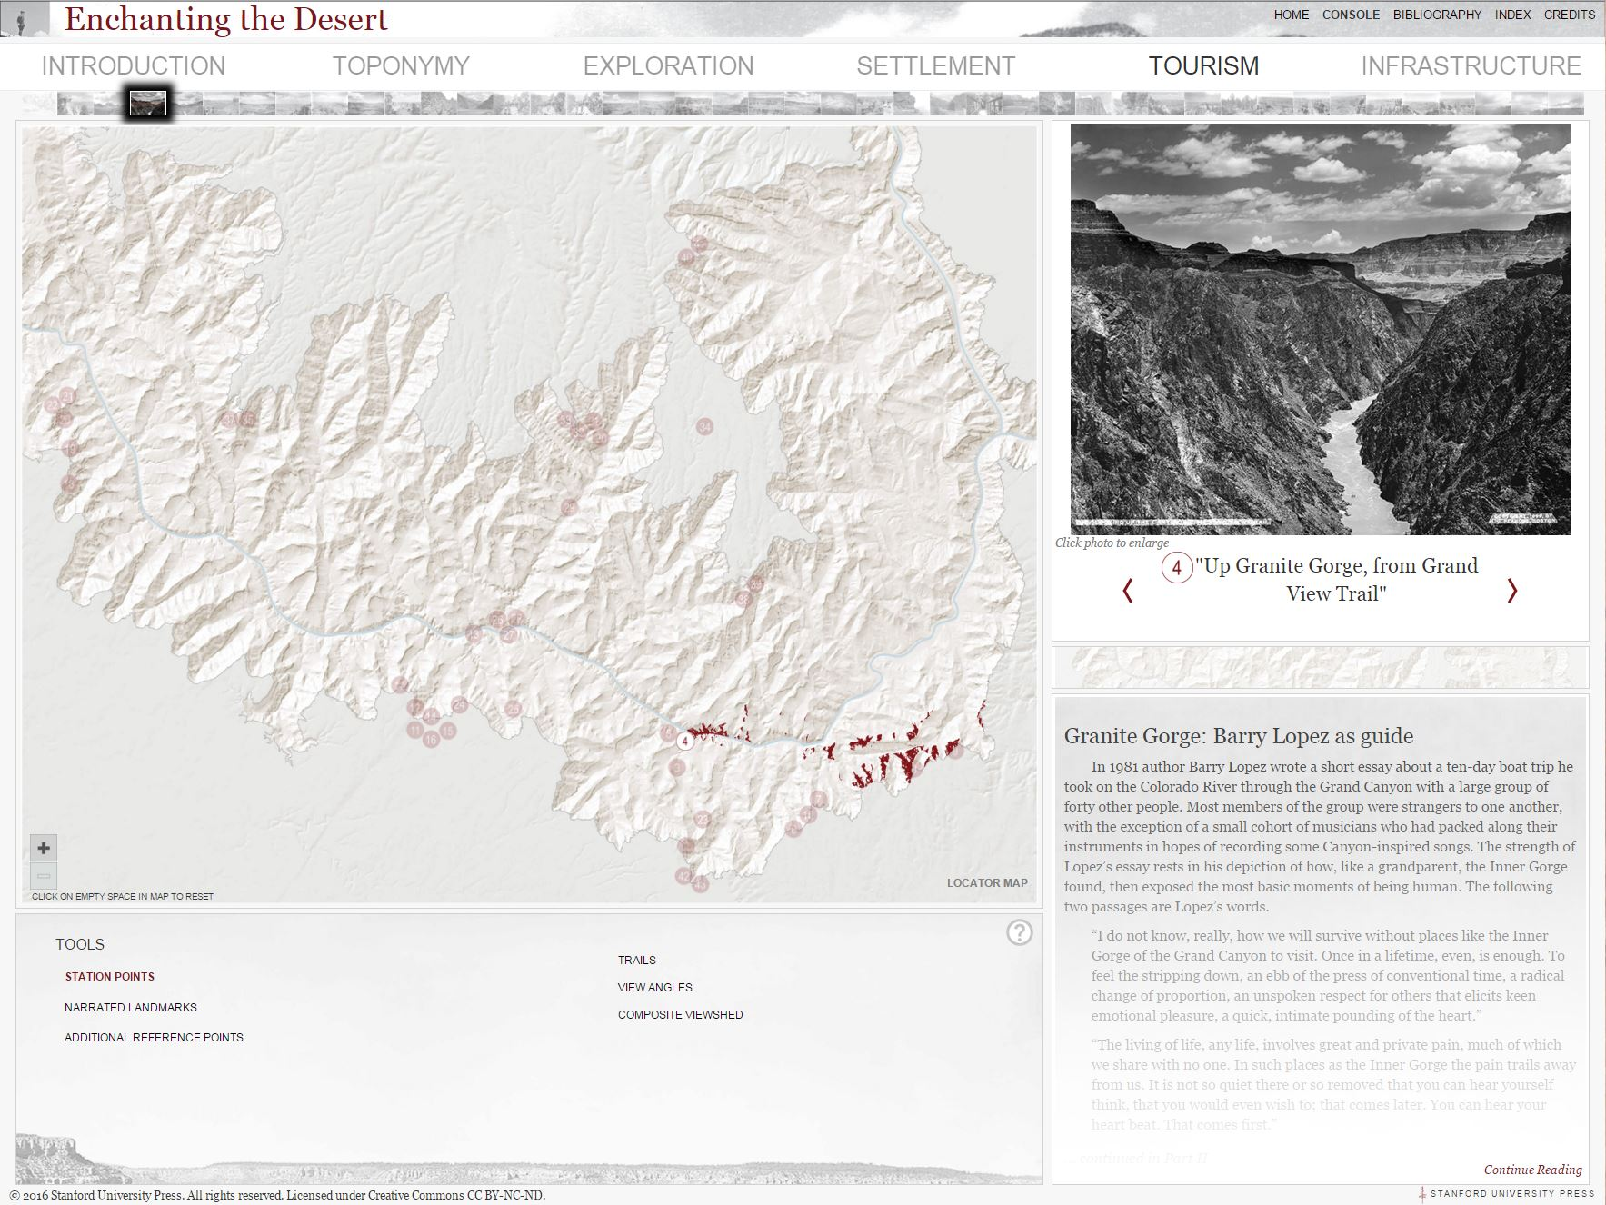

Slide 47
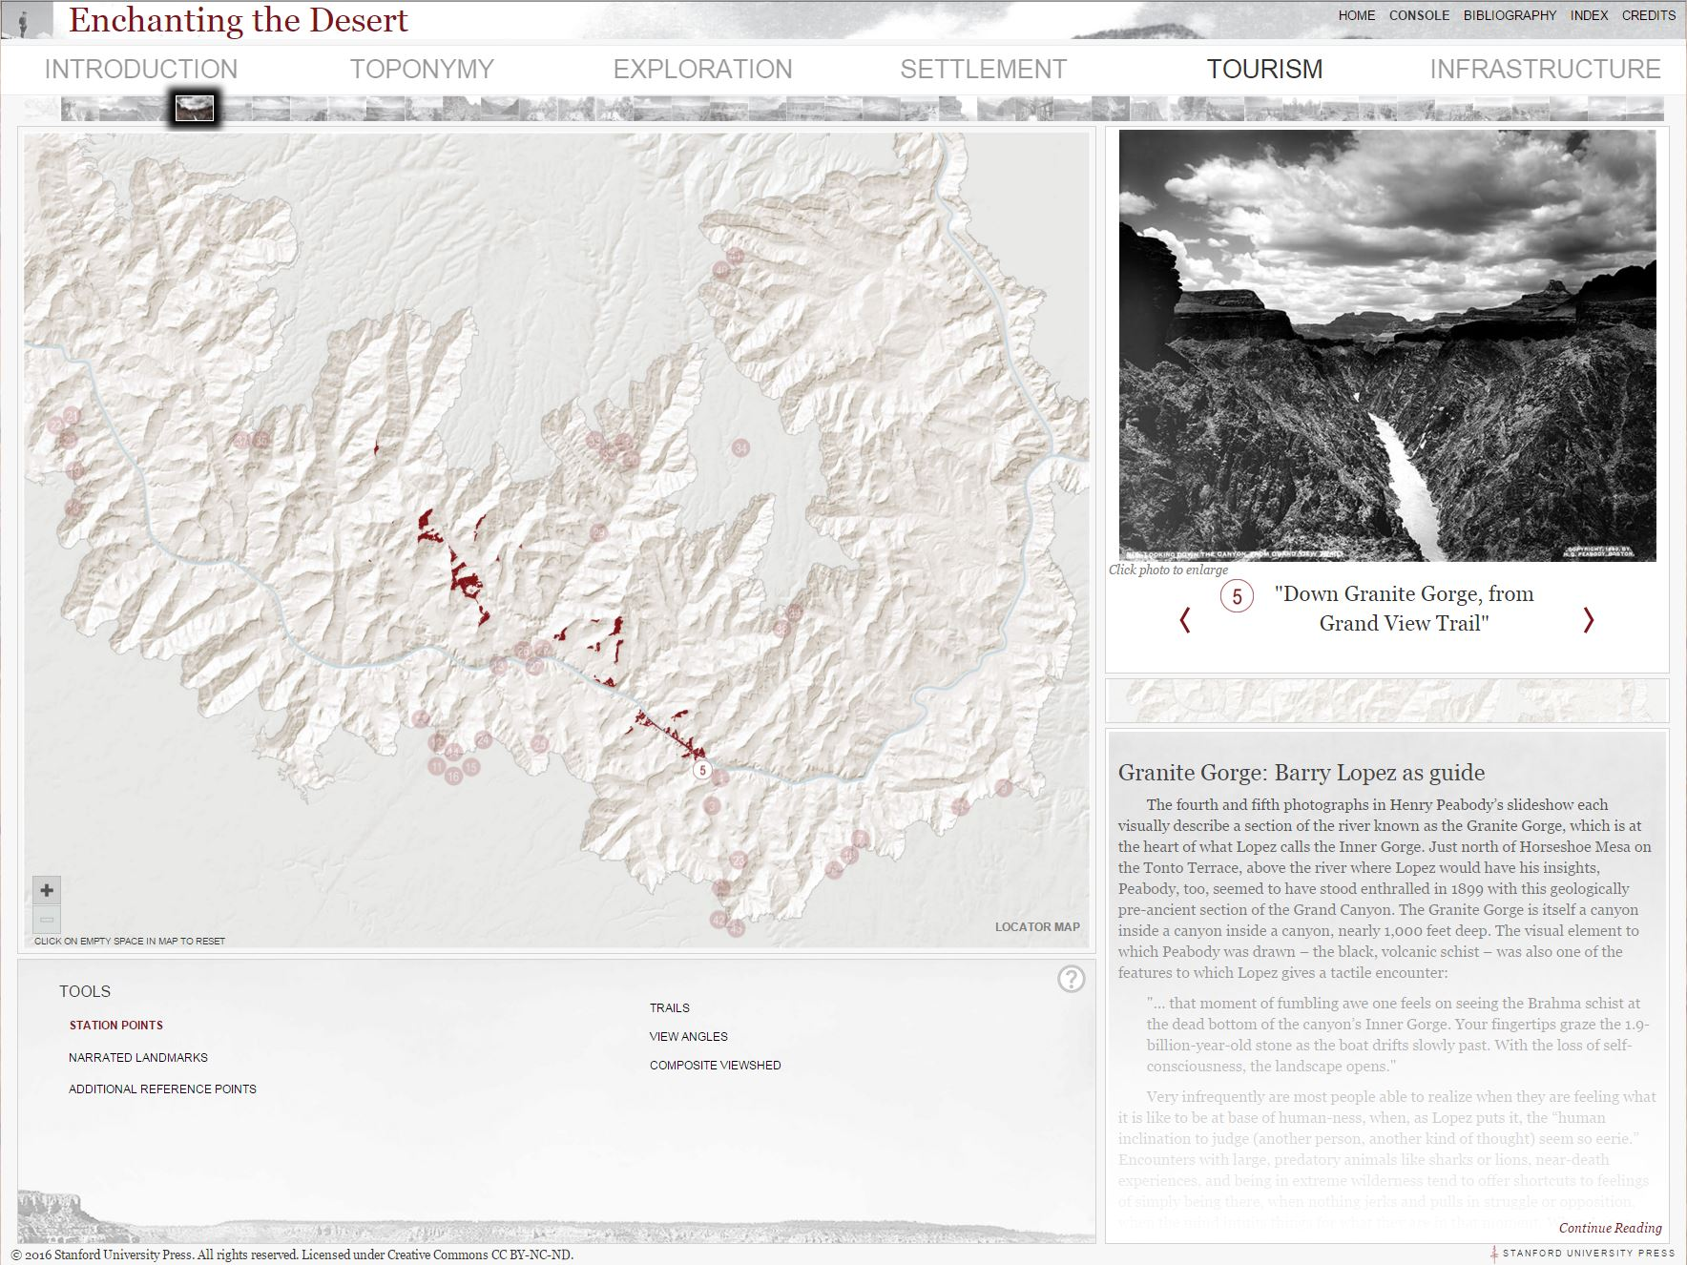

Slide 48
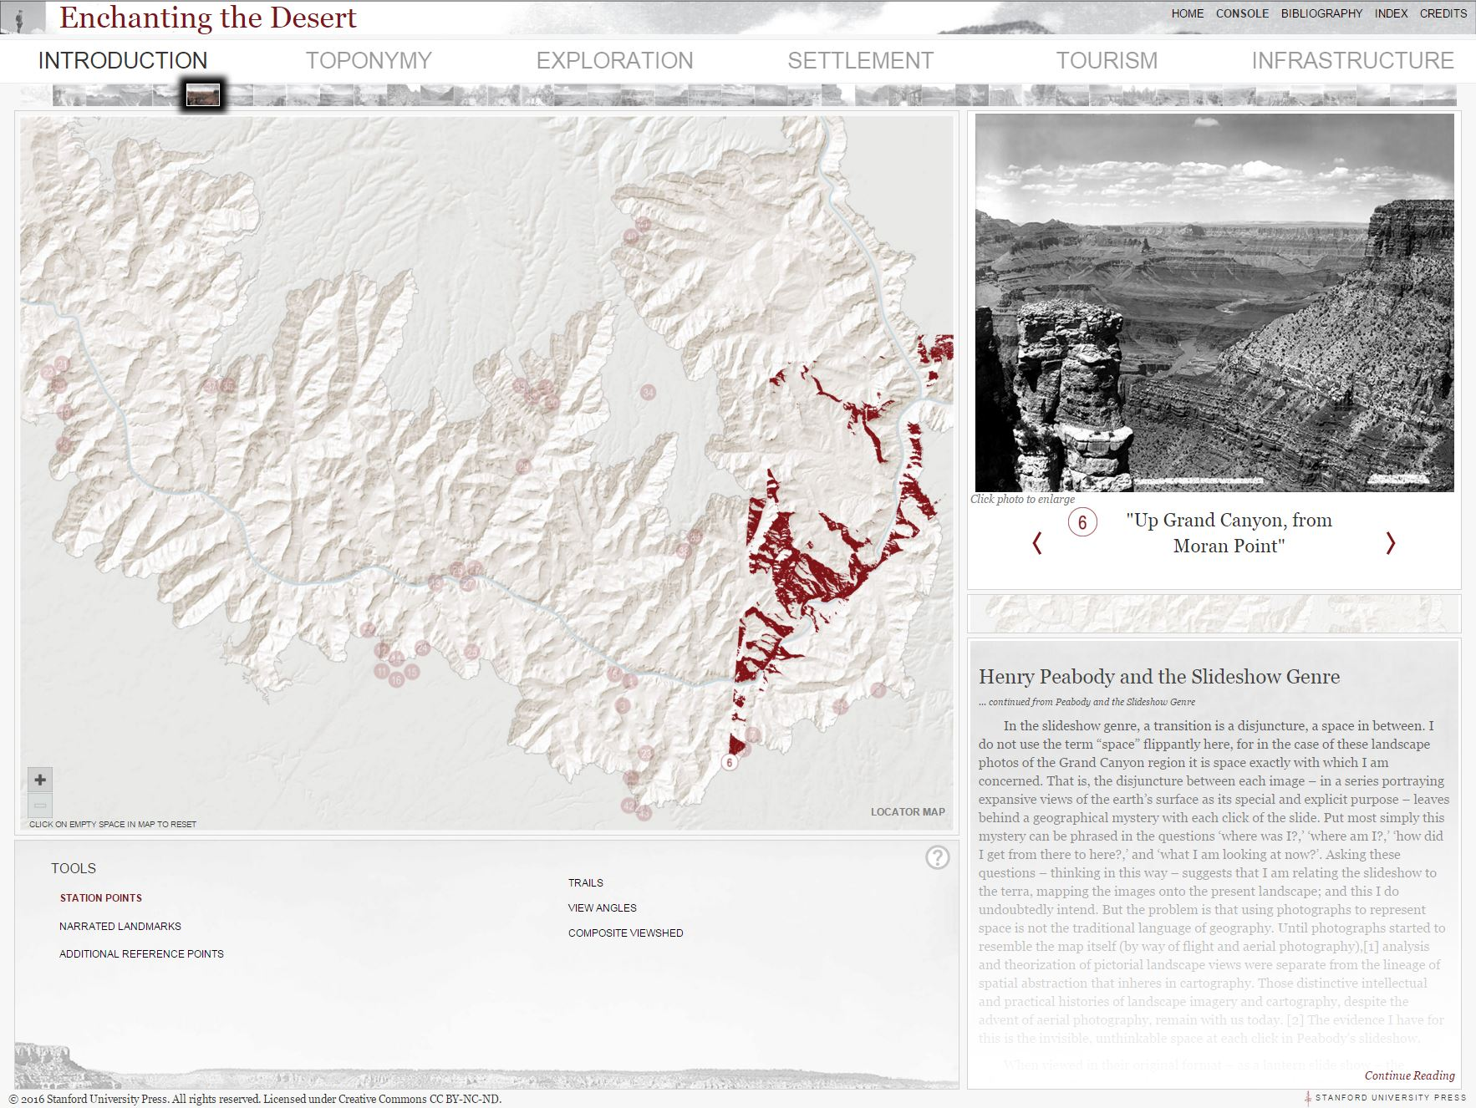

Slide 49


Slide 50


Slide 51


Slide 52


Slide 53


Slide 54


Slide 55


Slide 56


